Slide 1
COURSEXXXX Hashing

Slide 2
Hashing Part 1: Concepts

Slide 3
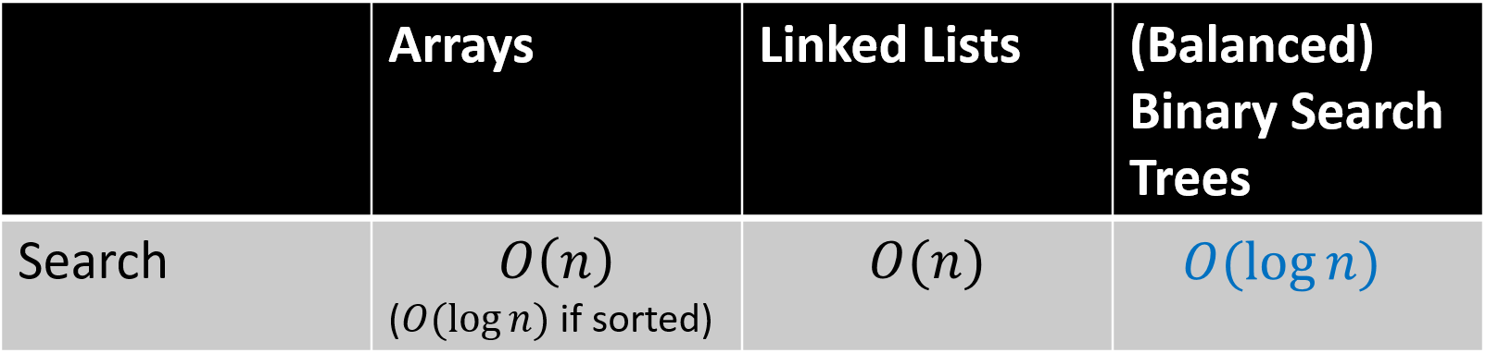
A Review of Binary Tree
Binary tree: A tree data structure with at most two child nodes for each node
Search process: Root node -> search the left/right subtree (target value is less/more than the current node -> repeat until the target value is found or a leaf node is reached
Question: Don’t we have any more efficient search techniques? Even O(1)

Slide 4
Arrays: Intuition✅
Address
Array
Index
You can put all the elements into a large array and then use the array index to search
The time complexity of the search is O(1)
Example: Quickly determine the address by six-digit postal code
Address0
Array[0]
00000000
Address1
Array[1]
00000001
………
………
HKUST(GZ)
Array[i]
00511453
………
………
HKUST
Array[j]
00999077
………
………

Slide 5
Arrays: Reflection🤔
Address
Array
Index
The number of postal codes is on the order of 10^6, but only 10^4 of them are actually used.
The space utilization rate is only 1%
A slight improvement forward, while ensuring O(1) search time and reducing space usage
Address0
Array[0]
00000000
………
………
(Empty)
Array[x]
00XXXXXX
(Empty)
Array[y]
00YYYYYY
………
………
HKUST
Array[j]
00999077
………
………

Slide 6
Hashing: Main Ideas
Some concepts
Core component | Implication
Bucket | A data structure (linked list or array) used to store data with the same hash value.
Hash table | An array of all buckets
Hash function | Input the specified key value and locate the specific bucket
Search process
Input the key value to the hash function
The result returned by the hash function is located in a bucket in the hash table
Search (or store) for data in the corresponding bucket

Slide 7
Back to The Example
Given a postal code (Key)
Locate the specific bucket through the hash function
Find the corresponding address from the bucket
Key
Address
HashTable
000000
Address0
Bucket[0]
000001
………
………
Hash Func.
HKUST(GZ)
Bucket[i]
511453
………
………
HKUST
Bucket[j]
999077

Slide 8
Hashing Part 2: Collision

Slide 9
Hashing: Collision
The hash function is a mapping from a large space to a small space (the number of keys is greater than the number of buckets)
There will definitely be a situation where multiple keys are mapped to the same bucket, which is called hash collision.
Key
000000
Address
HashTable
000001
Address0
Bucket[0]
………
HKUST(GZ)
………
Key mod 60953
511453
Bucket[j]
………
HKUST
999077

Slide 10
The Problem…..
If collisions are too frequent, the hash table will degenerate into a linked list.
For example, in extreme cases, if all keys are mapped to one bucket, an O(1) search becomes an O(n) search in a linked list of length n.
Key
Address[0]
000000
HashTable
000001
Address[1]
………
Bucket[0]
Address[2]
………
Hash Func.
511453
Bucket[i]
YYYYYY
………
………
………
Bucket[j]
XXXXXX
Hard to locate HKUST(GZ)
999077

Slide 11
Why Collision Occured
Reason1: Too few Buckets
load factor = #keys / #buckest
#buckest⬇️ -> #keys in on bucket⬆️ -> collision rate⬆️
Key
000000
Address[0]
HashTable
Extreme case of only one bucket
000001
………
Address[1]
Hash Func.
511453
Bucket
YYYYYY
Address[3]
………
………
XXXXXX
999077

Slide 12
Solution
Solution: Increase the number of buckets and thus put different keys into different buckets as much as possible
Disadvantages: Increased space usage; The probability of empty buckets increasing
HashTable
(Larger one)
Address
Key
Address0
Bucket[0]
000000
(Empty)
Bucket[1]
000001
Hash Func.
………
………
511453
HKUST(GZ)
Bucket[i]
………
………
999077
HKUST
Bucket[j]
………
………

Slide 13
Why Collision Occured
Reason2: Inappropriate hash function
If the hash function maps too many keys to the same bucket, the collision rate will also increase.
The ideal hash function needs to be able to evenly map the key to all buckets
Will be discussed detailed in part 3
Key
Address[0]
HashTable
000000
Bucket[0]
A Very Dumb One
000001
Address[1]
………
Bucket[1]
Address[3]
511453
Bucket[2]
Hash(Key)=Const
YYYYYY
………
………
………
Bucket[j]
………
XXXXXX
999077

Slide 14
But If Collision Has Occurred…
Collisions are inevitable. In addition to finding ways to reduce the collision rate, we should also find ways to resolve collisions after they occur.
Will be discussed detailed in part 4
Key
………
000000
Address[0]
HashTable
000001
………
Bucket[0]
Address[1]
………
Colli. Reso.
Hash Func.
511453
Address[3]
Bucket[i]
YYYYYY
………
………
………
Bucket[j]
Eariser to locate HKUST(GZ)
XXXXXX
Address[3]
999077
………

Slide 15
Hashing Part 3: Hash Func.

Slide 16
Hash Function: Division
h(k) = k % D maps a key k to bucket [0, D-1], where D is the required number of buckets. The remainder serves as k's home bucket.
Avoid D = 2^p or 10^p as divisors - they only use lower-order bits/digits, causing poor distribution when keys share similar patterns.
Use prime numbers (best) or odd numbers for D to maximize bit utilization and achieve uniform distribution, reducing collisions.

Slide 17
Hash Function: Division
h(k) = k % D is a uniform hash function. But, for a subset of the entire key space used in an application, we don’t know if it can still be uniform.
Consider a set of keys
8, 12, 16, 20, 24, 38
If D=14 (only even buckets are used)
0 2 4 6 8 10 12
If D=13 (both odd and even buckets are used)
 |  | 16 |  |  |  | 20 |  | 8 |  | 24 38 |  | 12
 |  | 38 | 16 |  |  |  | 20 | 8 |  |  | 24 | 12

Slide 18
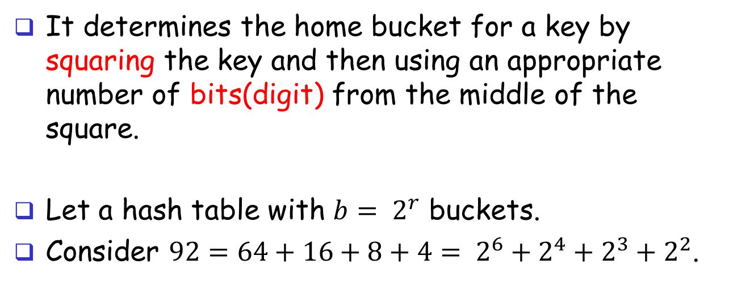
Hash Function: Mid-Square
It determines the home bucket for a key by squaring the key and then using an appropriate number of bits(digit) from the middle of the square.
Let a hash table with ${b= 2}^{r}$ buckets.
Consider $92={64+16+8+4= 2}^{6}+2^{4}+2^{3}+2^{2}$.
0
0
0
0
0
1
0
1
1
1
0
0
92
0
1
0
0
0
0
1
0
0
0
1
0
0
0
0
92x92=8464
r bits

Slide 19
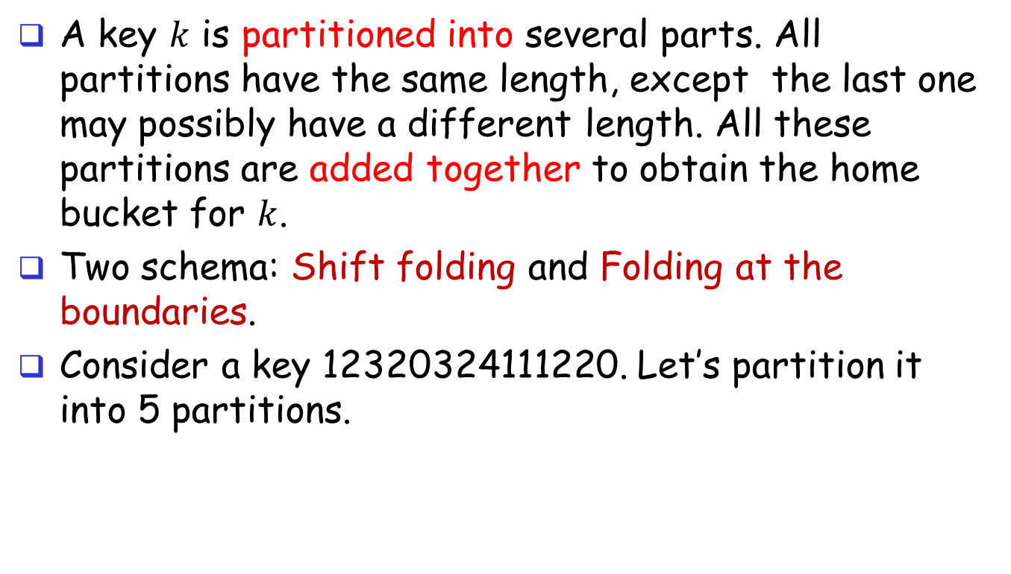
Hash Function: Folding
A key $k$ is partitioned into several parts. All partitions have the same length, except the last one may possibly have a different length. All these partitions are added together to obtain the home bucket for $k$.
Two schema: Shift folding and Folding at the boundaries.
Consider a key 12320324111220. Let’s partition it into 5 partitions.
P1
P2
P3
P4
P5
1
2
3
2
0
3
2
4
1
1
1
2
2
0

Slide 20
Hash Function: Folding
P1
1 2 3
P1
1 2 3
P2
2 0 3
P2
3 0 2
P3
2 4 1
P3
2 4 1
P4
1 1 2
P4
2 1 1
P5
2 0
P5
2 0
6 9 9
8 9 7
Shift folding
Folding at the boundaries

Slide 21
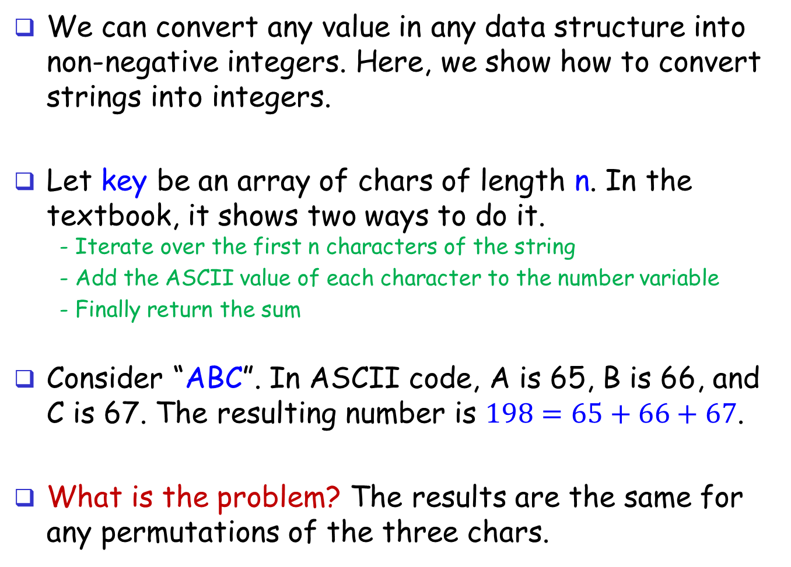
Convert Strings -> Integers
We can convert any value in any data structure into non-negative integers. Here, we show how to convert strings into integers.
Let key be an array of chars of length n. In the textbook, it shows two ways to do it. - Iterate over the first n characters of the string
- Add the ASCII value of each character to the number variable
- Finally return the sum
Consider “ABC”. In ASCII code, A is 65, B is 66, and C is 67. The resulting number is $198=65+66+67$.
What is the problem? The results are the same for any permutations of the three chars.

Slide 22
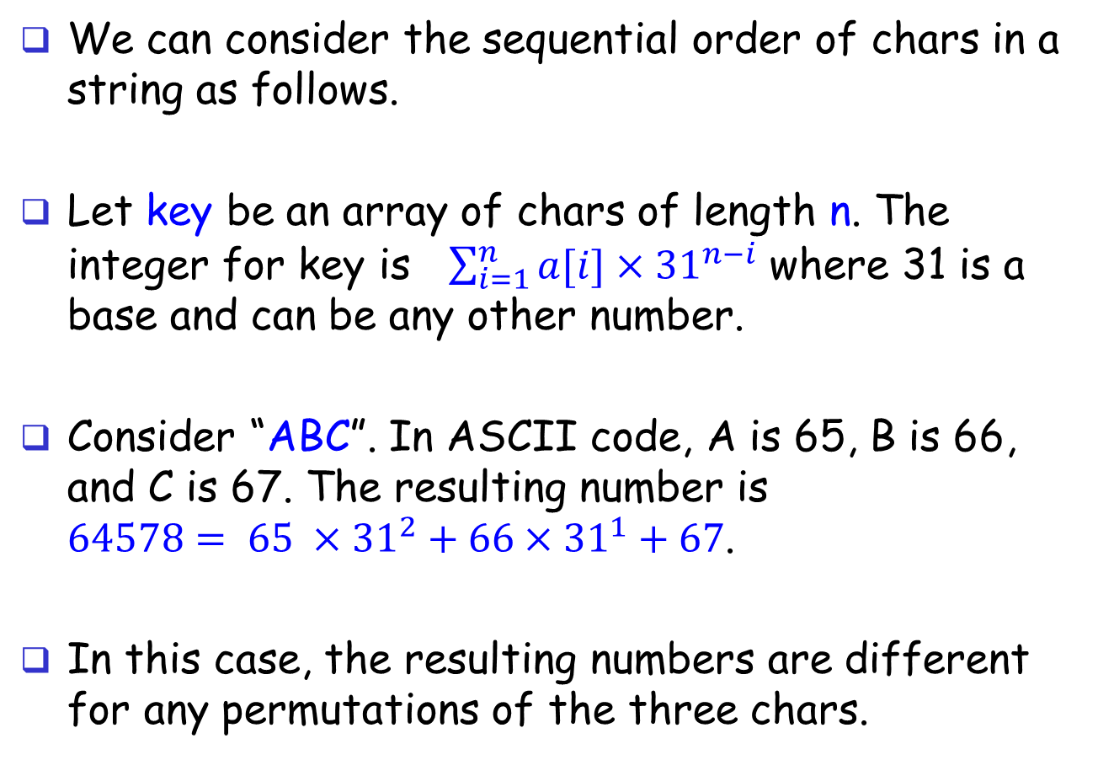
Convert Strings -> Integers
We can consider the sequential order of chars in a string as follows.
Let key be an array of chars of length n. The integer for key is $\sum_{i=1}^{n}{a[i]×{31}^{n−i}}$ where 31 is a base and can be any other number.
Consider “ABC”. In ASCII code, A is 65, B is 66, and C is 67. The resulting number is $64578= 65 ×{31}^{2}+{66×31}^{1}+67$.
In this case, the resulting numbers are different for any permutations of the three chars.

Slide 23
A Good Hash Function
Deterministic
A key can only have one hash value after being mapped by a hash function.
Key
Key
HashTable
HashTable
000000
000000
Bucket[0]
000001
Bucket[0]
000001
✅
❌
………
………
………
………
Hash Func.
Hash Func.
Bucket[i]
511453
Bucket[i]
511453
………
………
………
………
Bucket[j]
Bucket[j]
999077
999077

Slide 24
A Good Hash Function
Efficiency
Function Hash(Key) can be realized in O(1) time.
Surjective
All buckets must be covered after hash mapping all keys
Key
Key
HashTable
HashTable
000000
000000
Bucket[0]
000001
Bucket[0]
000001
✅
❌
………
………
………
………
Bucket[i]
Hash Func.
Hash Func.
Bucket[i]
511453
511453
Bucket[j]
Bucket[j]
………
………
………
………
Bucket[n]
Bucket[n]
999077
999077

Slide 25
A Good Hash Function
Uniformity
After performing hash mapping on all keys, the number of items in each bucket is similar.
Key
Entries
HashTable
000000
Entry 1
Bucket[0]
000001
❌
………
………
Hash Func.
…
Entry n
Entry 2
Entry 1
Bucket[i]
511453
………
………
Entry 2
Entry 1
Bucket[j]
999077

Slide 26
A Good Hash Function
Uniformity
After performing hash mapping on all keys, the number of items in each bucket is similar.
Entries
Key
HashTable
000000
…
Entry n
Entry 2
Entry 1
Bucket[0]
000001
✅
………
………
Hash Func.
…
Entry n
Entry 2
Entry 1
Bucket[i]
511453
………
………
Entry n
…
Entry 2
Entry 1
Bucket[j]
999077

Slide 27
Reflection of Uniformity
A good hash function should create linked lists of roughly the same size.
When uniformity is destroyed, search performance will drop from O(1) to O(n) in extreme cases.
Is there a set of hash functions that satisfy uniformity, so that the search performance (at least on average) is O(1)? -> Universal Hashing
Key
HashTable
000000
Address[0]
Bucket[0]
A Very Dumb One
000001
………
Address[1]
Bucket[1]
511453
Bucket[2]
Hash(Key)=Const
YYYYYY
Address[3]
………
………
………
Bucket[j]
XXXXXX
………
999077

Slide 28
Universal Hashing: Definition
Let S be a set of n integers, our goal is to build a data structure on S to answer if the query q∈S
Let H be a family of hash functions from [U] (from 1 to #Keys) -> [m] (from 1 to #Buckets)
H is universal if the following holds:
Let k1, k2 be two distinct integers in [U], By picking a function h∈H uniformly at random, we guarantee that Pr[(h(k1)) = [(h(k2))] ≤ 1/m

Slide 29
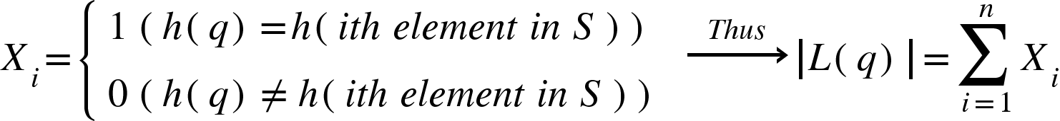
Query Time Analysis
We focus on the case where query q∉S
We Assume that while the length of the linked list is L(q), the time cost of probing all the elements in the linked list is O(L(q))
Define random variable Xi (1 ≤ i ≤ n)

Slide 30
Query Time Analysis
By universality, Pr[Xi = 1] ≤ 1/m
meaning that E[Xi] = 1 × Pr[Xi = 1] + 0 × Pr[Xi = 0] ≤ 1/m
Hence: E[|L(q)|] = E[X1] + E[X2] + ···· + E[Xn] ≤ n/m
By choosing m = Θ(n), we have E[|L(q)|] ≤ n/m = O(1)

Slide 31
To Obtain a Universal Function
We now construct a universal family H of hash functions from [U] to [m]
Pick a prime number p such that p ≥ m and p ≥ U.
For every α∈{1, 2, ..., p - 1} and every β∈{0, 1, ..., p - 1}, define:
This defines p(p - 1) hash functions, which constitute our H

Slide 32
Existence of the Prime Number
Is it always possible to choose a desired prime number p?
Recall that the RAM model is defined with a word length w, namely, the number of bits in a word. Hence, U ≤ 2^w - 1
Number theory shows that there is at least one prime number between x and 2x.
Hence, one can prepare in advance such a prime number p in the range [2^w, 2^w+1] and use this p to construct a universal hash family.

Slide 33
Hashing Part 3: Colli. Handling

Slide 34
Intro.
When an overflow occurs, we cannot insert a record into its home bucket, because by overflow it means that the home bucket is full. We have to handle overflow by finding a new place to insert a new record.
Two methods:
Chaining: each bucket uses a linked list, assuming s=1
Open Addressing: Search a bucket that is not full yet in the hash table in a systematic manner.
Linear probing (known as linear open addressing)
Quadratic probing
Rehashing

Slide 35
Muti-Slots: Intuition✅
Structure: The Bucket unit is further subdivided into several slots, each of which stores conflicting entries.
Search: After locating a bucket, further traverse the slots in the bucket and finally find the target element
Key
……
Slot n
Slot 2
Slot 1
HashTable
000000
…
(Empty)
(Empty)
Entry 1
Bucket[0]
000001
………
………
Hash Func.
…
Entry n
Entry 2
Entry 1
Bucket[i]
511453
………
………
…
(Empty)
Entry 2
Entry 1
Bucket[j]
999077

Slide 36
Muti-Slots: Reflection🤔
Number of slots: Must be predetermined and cannot be dynamically adjusted. Having too many slots leads to wasted space.
Improvement: Use a linked list approach that allows dynamic adjustment of slot sizes.
Key
……
Slot n
Slot 2
Slot 1
HashTable
000000
…
(Empty)
(Empty)
Entry 1
Bucket[0]
000001
………
………
Hash Func.
…
Entry n
Entry 2
Entry 1
Bucket[i]
511453
………
………
…
(Empty)
Entry 2
Entry 1
Bucket[j]
999077

Slide 37
Chaining
Structure: Allow a bucket to be variable length using a linked list.
Search: First locate the corresponding Bucket, then traverse the linked list corresponding to the bucket until the target element is found
Key
Entries
HashTable
000000
Entry 1
Bucket[0]
000001
✅
………
………
Hash Func.
Entry 3
Entry 2
Entry 1
Bucket[i]
511453
………
………
Entry 2
Entry 1
Bucket[j]
999077

Slide 38
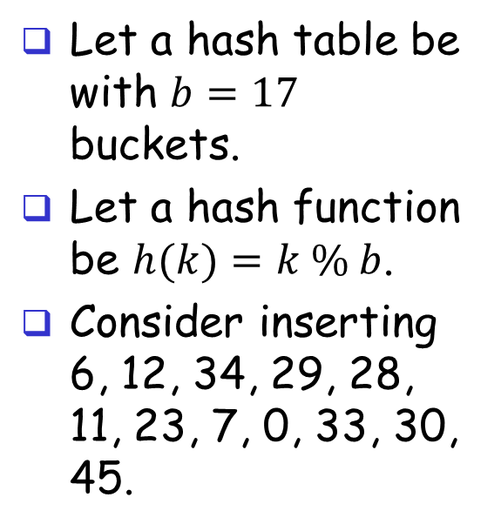
E.g. of Chaining
[0]
34
0
Let a hash table be with $b=17$ buckets.
Let a hash function be $h(k)=k \% b$.
Consider inserting 6, 12, 34, 29, 28, 11, 23, 7, 0, 33, 30, 45.
[4]
6
23
7
[8]
11
28
45
[12]
12
29
30
[16]
33

Slide 39
Reflection of Chaining
The Chaining method can resolve Collision to some extent, but the disadvantage is that it requires additional space to store the linked list.
The hash table occupies continuous space in memory. Is it possible to resolve conflicts in this continuous memory? -> Open Addressing
HashTable
HashTable
Entry 1
Bucket[0]
Bucket[0]
………
………
Entry 2
Entry 1
Bucket[i]
Bucket[i]
………
………
Entry 1
Bucket[j]
Bucket[j]

Slide 40
Linear Probing: Inserting
When inserting a new record with a key k
Use the hash function h(k) to calculate the initial position.
Starting from the initial position, search in the order ht[(h(k)+i)%b], where i ranges from 0 to b−1(bucket_size - 1), until an empty slot is found.
Once an empty slot is found, insert the new record at that position.

Slide 41
Linear Probing: Inserting
Example of Inserting
Let a hash table be with b = 17 buckets, and hash function be h(k)=k % b
Consider inserting 6, 12, 34, 29, 28, 11, 23, 7, 0, 33, 30, 45.
0
4
8
12
16
34
0
45
6
23
7
28
12
29
11
30
33

Slide 42
Linear Probing: Searching
searching for a given key k
Calculate the hash value h(k)
Examine the hash table positions in the order ht[(h(k)+i)%b] , starting from i=0, until one of the following occurs:
Target key found: The record at the current position ht[(h(k)+i)%b] contains the key k, and the search is successful.
Empty slot: The current position is empty, indicating that the key k is not in the hash table.
Table full: The search returns to the initial position ht[h(k)], indicating that the table is full and the key is not in the table.

Slide 43
Reflection
Problem of linear probing: It intends to have a cluster, which is a block of contiguously occupied slots.
How do we deal with a cluster keeping growing?
-> Quadratic Probing
The bigger a cluster is, the more likely it will be even bigger when a new key is hashed into the cluster.
The larger the cluster the slower the performance.

Slide 44
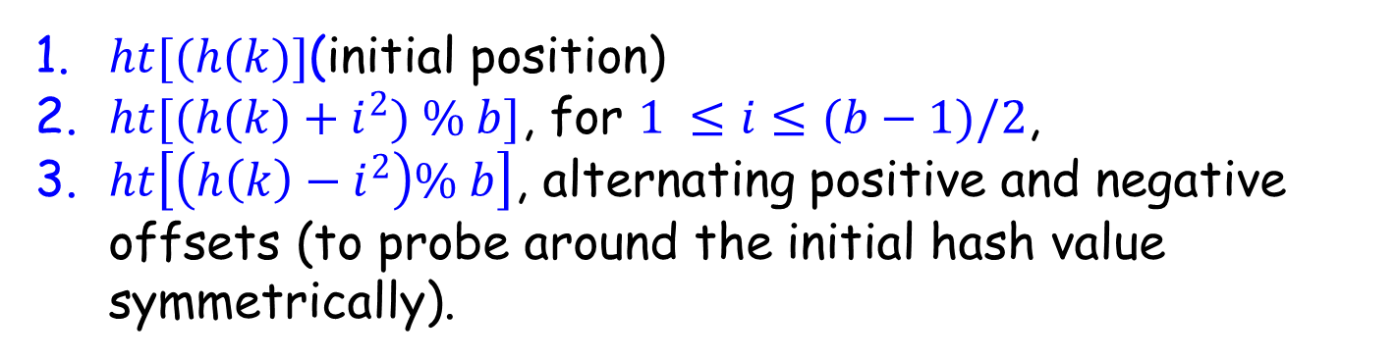
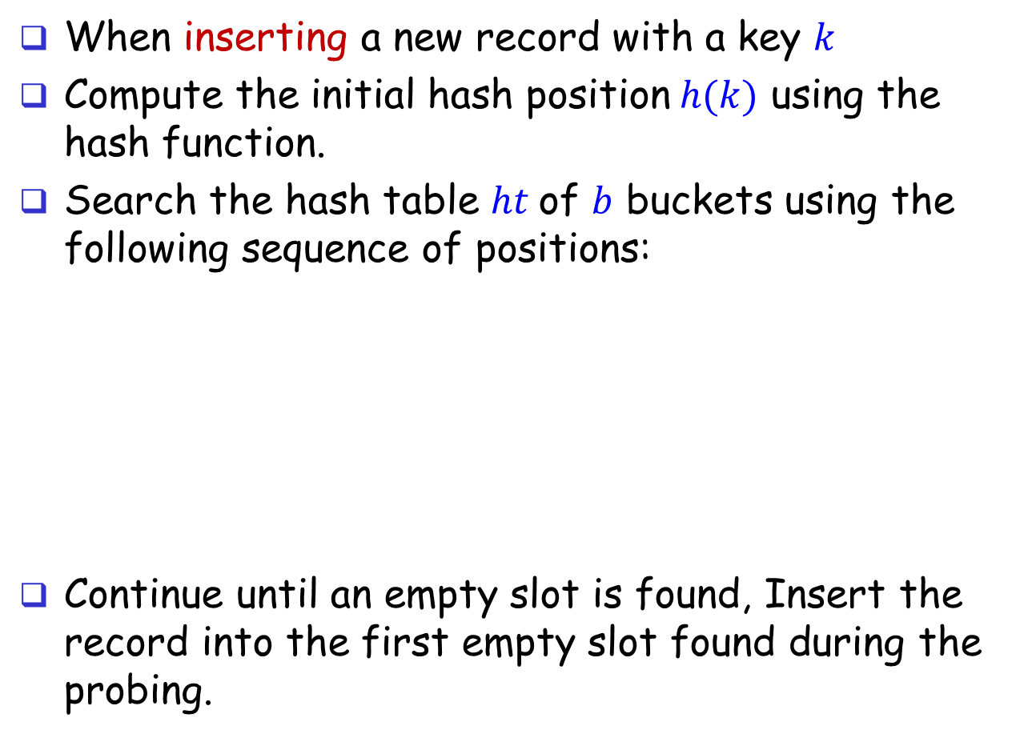
Quadratic Probing: Inserting
When inserting a new record with a key $k$
Compute the initial hash position$h(k)$ using the hash function.
Search the hash table $ht$of $b$ buckets using the following sequence of positions:
Continue until an empty slot is found, Insert the record into the first empty slot found during the probing.
$ht[(h(k)]$(initial position)
$ht[(h(k)+i^{2}) \% b]$, for $1 ≤i≤(b−1)/2$,
$ht\left[\left(h\left(k\right)−i^{2}\right)\% b\right]$, alternating positive and negative offsets (to probe around the initial hash value symmetrically).

Slide 45
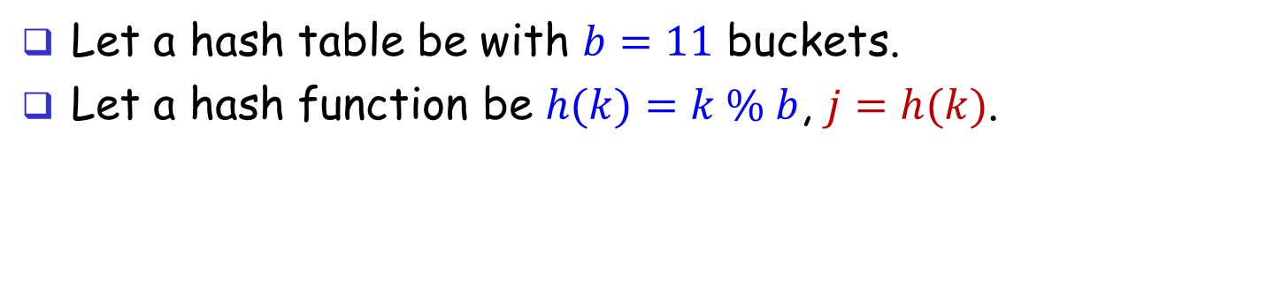
Quadratic Probing: Example
Let a hash table be with $b=11$ buckets.
Let a hash function be $h(k)=k \% b$, $j=h(k)$.
j | j+1 | j-1 | j+4 | j-4 | j+9 | j-9 | j+16 | j-16 | j+25 | j-25
0 | 1 | - | 4 | - | 9 | - | 5 | - | 3 | -
1 | 2 | 0 | 5 | - | 10 | - | 6 | - | 4 | -
2 | 3 | 1 | 6 | - | 0 | - | 7 | - | 5 | -
3 | 4 | 2 | 7 | - | 1 | - | 8 | - | 6 | -
4 | 5 | 3 | 8 | 0 | 2 | - | 9 | - | 7 | -
5 | 6 | 4 | 9 | 1 | 3 | - | 10 | - | 8 | -
6 | 7 | 5 | 10 | 2 | 4 | - | 0 | - | 9 | -
7 | 8 | 6 | 0 | 3 | 5 | - | 1 | - | 10 | -
8 | 9 | 7 | 1 | 4 | 6 | - | 2 | - | 0 | -
9 | 10 | 8 | 2 | 5 | 7 | 0 | 3 | - | 1 | -
10 | 0 | 9 | 3 | 6 | 8 | 1 | 4 | - | 2 | -

Slide 46
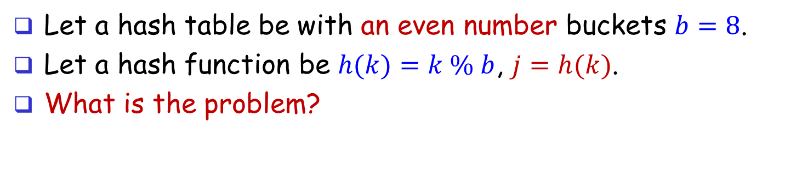
Quadratic Probing: Example
Let a hash table be with an even number buckets $b=8$.
Let a hash function be $h(k)=k \% b$, $j=h(k)$.
What is the problem?
j | j+1 | j-1 | j+4 | j-4 | j+9 | j-9 | j+16 | j-16
0 | 1 | - | 4 | - | 1 | - | 0 | -
1 | 2 | 0 | 5 | - | 2 | - | 1 | -
2 | 3 | 1 | 6 | - | 3 | - | 2 | -
3 | 4 | 2 | 7 | - | 4 | - | 3 | -
4 | 5 | 3 | 0 | 0 | 5 | - | 4 | -
5 | 6 | 4 | 1 | 1 | 6 | - | 5 | -
6 | 7 | 5 | 2 | 2 | 7 | - | 6 | -
7 | 0 | 6 | 3 | 3 | 0 | - | 7 | -

Slide 47
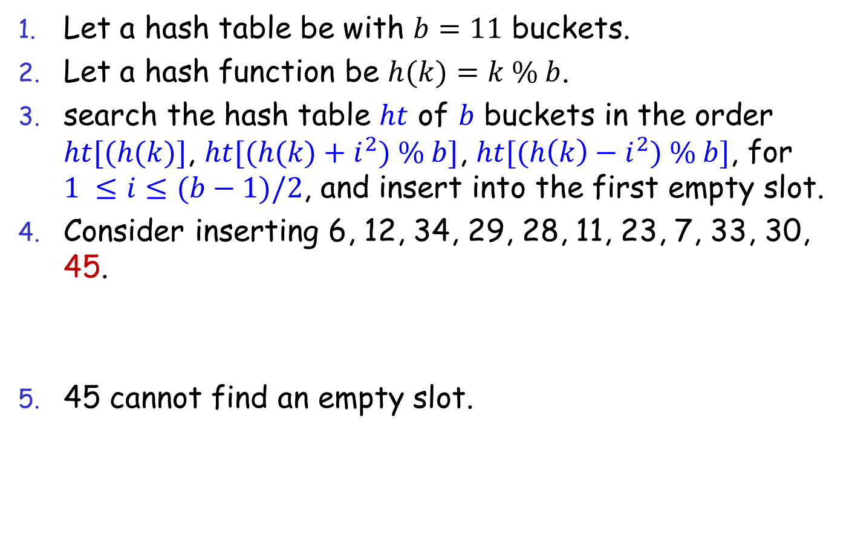
Reflection
Can Quadratic Probing always find an empty slot?
Let a hash table be with $b=11$ buckets.
Let a hash function be $h(k)=k \% b$.
search the hash table $ht$ of $b$ buckets in the order $ht[(h(k)]$, $ht[(h(k)+i^{2}) \% b]$, $ht[(h\left(k\right)−i^{2}) \% b]$, for $1 ≤i≤(b−1)/2$, and insert into the first empty slot.
Consider inserting 6, 12, 34, 29, 28, 11, 23, 7, 33, 30, 45.
45 cannot find an empty slot.
0
4
8
10
11
12
34
33
28
6
29
7
30
23

Slide 48
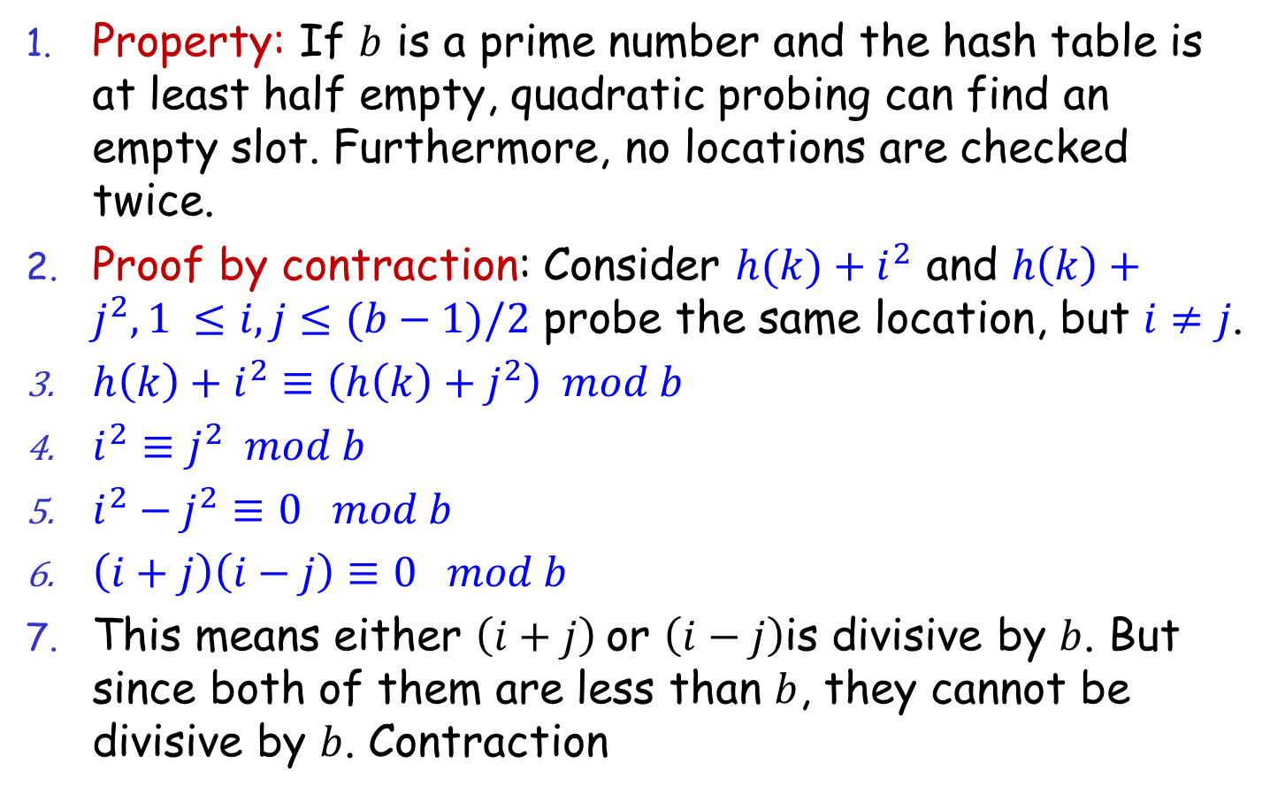
Reflection
Guarantee of Quadratic Probing
Property: If $b$ is a prime number and the hash table is at least half empty, quadratic probing can find an empty slot. Furthermore, no locations are checked twice.
Proof by contraction: Consider $h(k)+i^{2}$ and $h\left(k\right)+j^{2},1 ≤i,j≤(b−1)/2$ probe the same location, but $i≠j$.
$h\left(k\right)+i^{2}≡\left(h\left(k\right)+j^{2}\right) mod b$
$i^{2}≡j^{2} mod b$
$i^{2}−j^{2}≡0 mod b$
$\left(i+j\right)\left(i−j\right)≡0 mod b$
This means either $\left(i+j\right)$or $\left(i−j\right)$is divisive by $b$. But since both of them are less than $b$, they cannot be divisive by $b$. Contraction

Slide 49
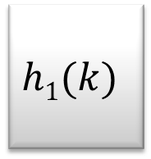
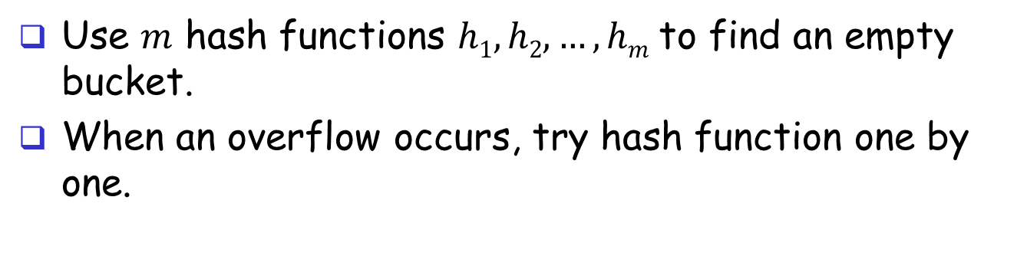

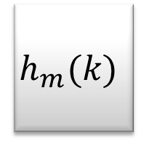
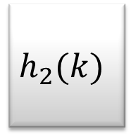
Hash Function: Rehashing
Use $m$ hash functions $h1, h2, …, hm$to find an empty bucket.
When an overflow occurs, try hash function one by one.
$$h1(k)$$
$$h_{2}(k)$$
$$h_{m}(k)$$
$$k$$

Slide 50
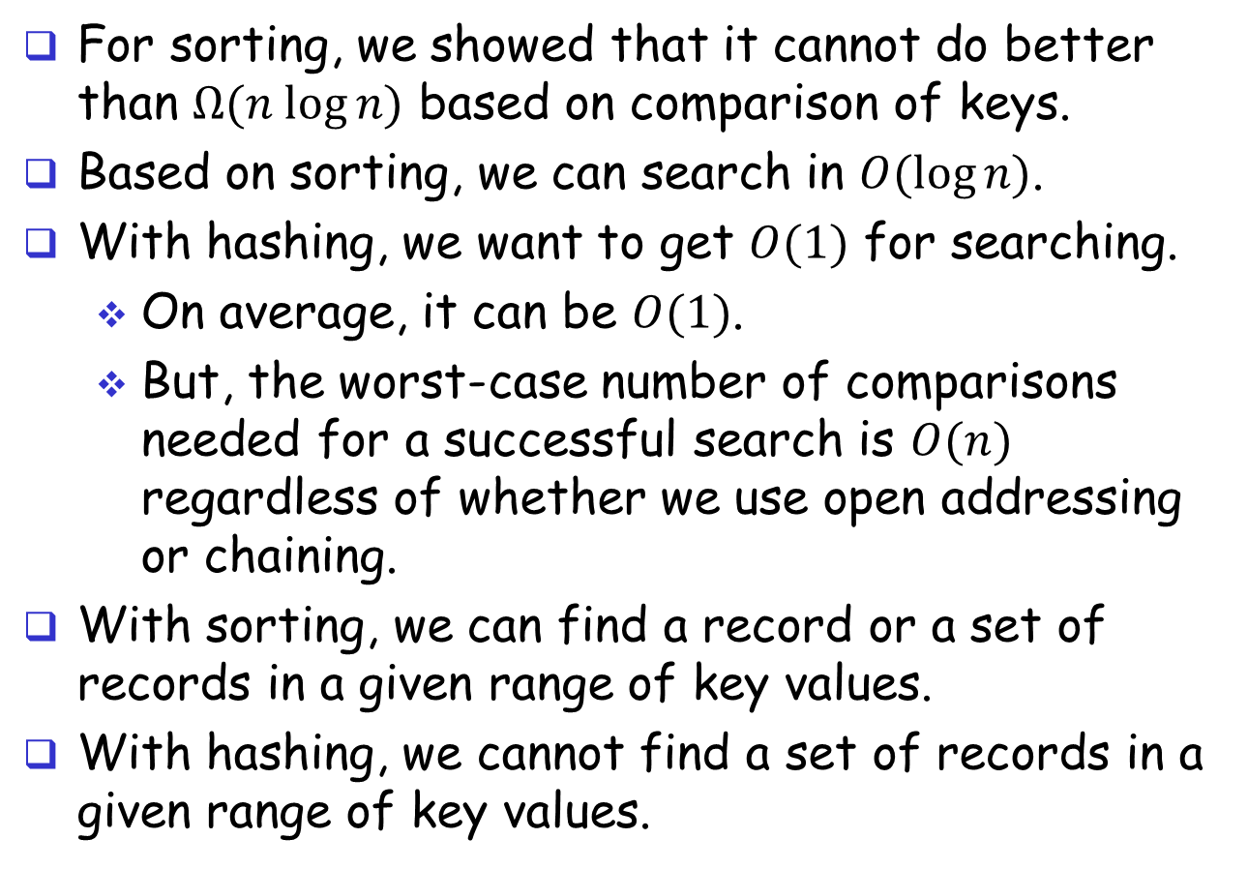
Sorting vs Hashing
For sorting, we showed that it cannot do better than $Ω(n log⁡n)$ based on comparison of keys.
Based on sorting, we can search in $O(log⁡n)$.
With hashing, we want to get $O(1)$ for searching.
On average, it can be $O(1)$.
But, the worst-case number of comparisons needed for a successful search is $O(n)$ regardless of whether we use open addressing or chaining.
With sorting, we can find a record or a set of records in a given range of key values.
With hashing, we cannot find a set of records in a given range of key values.

